Slide 1
WELCOME
TO OUR
8TH GRADE
Transition to High School
Parent/Guardian Info Night

Slide 2
Agenda Items
Introductions - HSI-Katy College and Career Counseling Team Alpha-Split Ms.Kose
Why Us? Our school information, success, awards, test scores, etc. -Ms.Hamadi
High School Graduation Requirements Endorsements (Pathways)-Mr.Yildiz
AP/Dual Credit/Honors/PLTW Courses-Ms.Gulsah
College Counseling Services -Ms.Hamadi
Extracurricular Activities -Transition Calendar -Mr.Yilmaz
High School Schedule -Mr.Yildiz
Course Selection Process, 9th Grade Core Classes - Ms.Ortiz
Resources and Support-Ms.Ortiz
Question & Answer Session

Slide 3
1.
TEAM PRESENTATION
Introductions - HSI-Katy College and Career Counseling Team

Slide 4
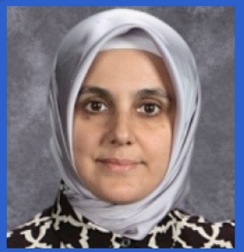
Meet our Dean’s of College and Career
Q
Ms.Kose Ms. Toliver
skose@harmonytx.org qtoliver@harmonytx.org

Slide 5
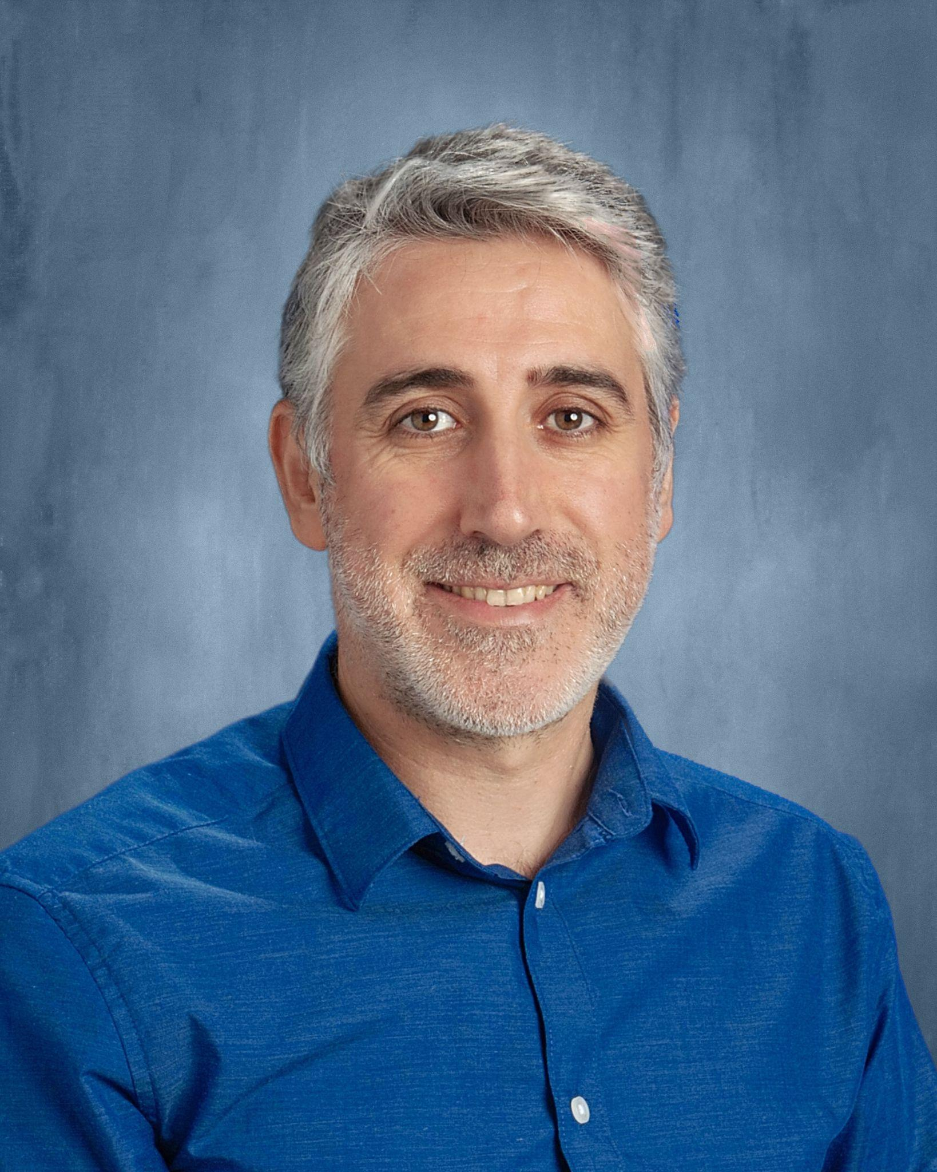
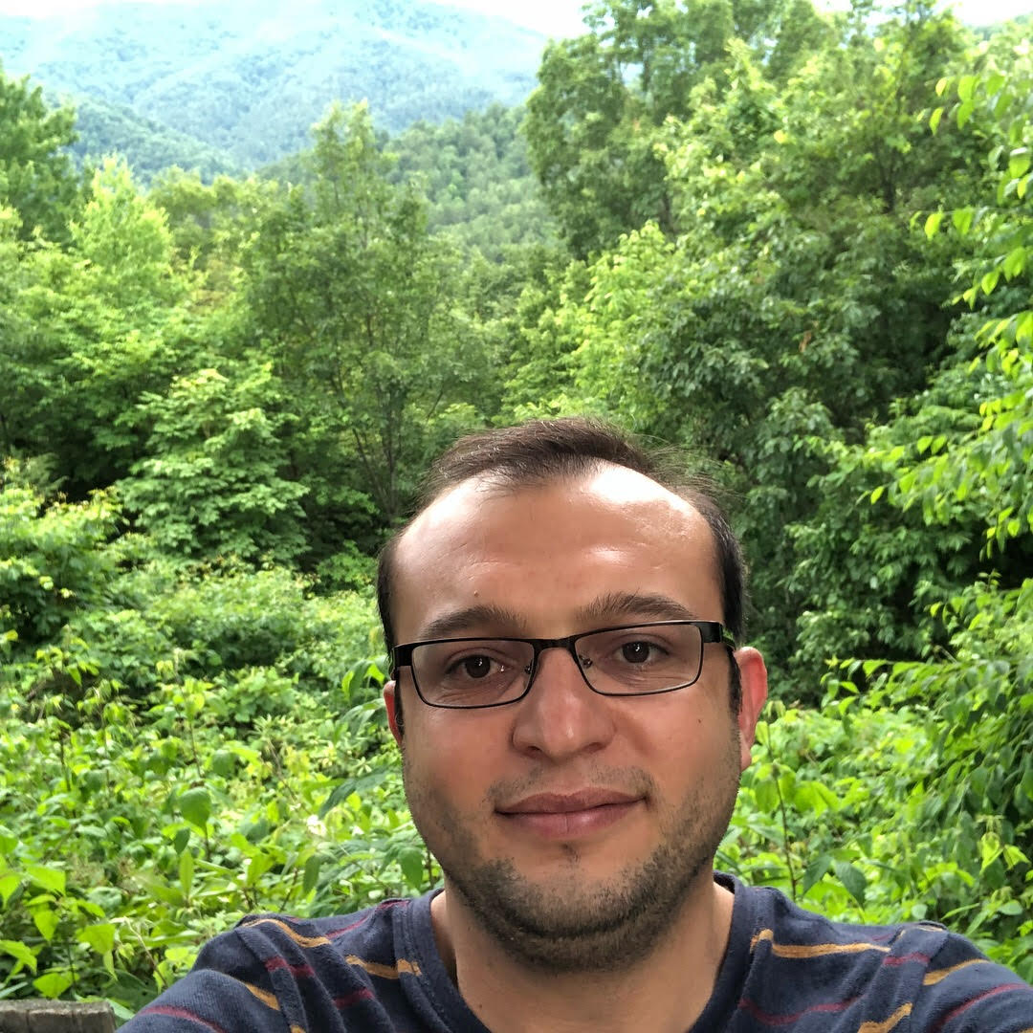
Team Presentation
Mr.Yildiz
muhammetyildiz@harmonytx.org
Alpha-Split
A-Del College and Career Counselor
Ms. Gulsah
gulsah.cavusoglu@harmonytx.org
Alpha-Split
Der-Kis College and Career Counselor
Mr.Yilmaz ertugrul.yilmaz @harmonytx.org
Alpha-Split
Kob-Pat College and Career Counselor
Ms.Hamadi
dhamadi@harmonytx.org
Alpha-Split
Pel-Z
College and Career Counselor
Ms. Ortiz
nortiz@harmonytx.org
Seminar Advisor

Slide 6
2.
WHY US?
Our school information, success, awards, test scores, etc.

Slide 7
Why Us?
College Counseling
Academic Counseling
Academic Competitions
STUDENT
SAT Preparation
1-on-1 Meetings
Financial Aid support
Competitive College Acceptances
Extracurricular Activities
Notes:
Robotics, TSA, GT etc
We have more than 60 clubs in our campus
We are building an American football team, indoor and outdoor basket ball

Slide 8
Why Us (cont..)?
High School Ranking
2023 U.S. News & World Report
Ranked HSI Katy
No. 6 in Houston
No. 39 in Texas
#1 HPS High School in Texas
Small School Environment
College Readiness 98%
STUDENT
State Distinguished Award
Graduate Rate %100
Anti-Bullying policy, Open Door policy
Saturday Tutorials
Alumni Outreach
Notes:
Small school helps having hands on activity, increases student behavior and participation

Slide 9
High School Graduation Requirements
TEXAS & HARMONY PUBLIC SCHOOLS
8th Grade Transition to High School

Slide 10
High School Graduation Requirements
HPS High School Credit Requirement (26)
Passing Score on Texas State Assessments (STAAR)
Algebra I, Biology, English I-II, and US History
Admission by a 4-Year College
Minimum 100 Community Service Hours
Community service requirement is 25 hours per year.
Completion of FAFSA/TASFA Application
Peace Officer Training
CPR Training
8th Grade Transition to High School

Slide 11
High School Graduation Requirements
A. English – 4 years required English I,II,III,IV (Eng. Lang AP, Eng. Lit. AP, Eng. 1301-1302 , Creative Writing)
B. Mathematics – 4 years required, Algebra I, Geometry, Algebra 2 and Advance Math Course (Pre-Cal, Cal, AP Stat.)
C. Science – 4 years required, Biology, Chemistry, Physics and Advance Science Course
D. Social Science – 4 years required (World Geography, World History, US History, Government & Econ)
E. Language other than English (LOTE)– 2 years required, 3 years recommended
*Two years of the same language other than English
F. Visual and Performing Arts (VPA) – 1 year required
G. Physical Education Foundation of Personal Fitness, Soccer or Basketball - 1 year required
H. College-Preparatory Electives – 6 Electives and 4 year required for Endorsements
= 26 credits
8th Grade Transition to High School

Slide 12
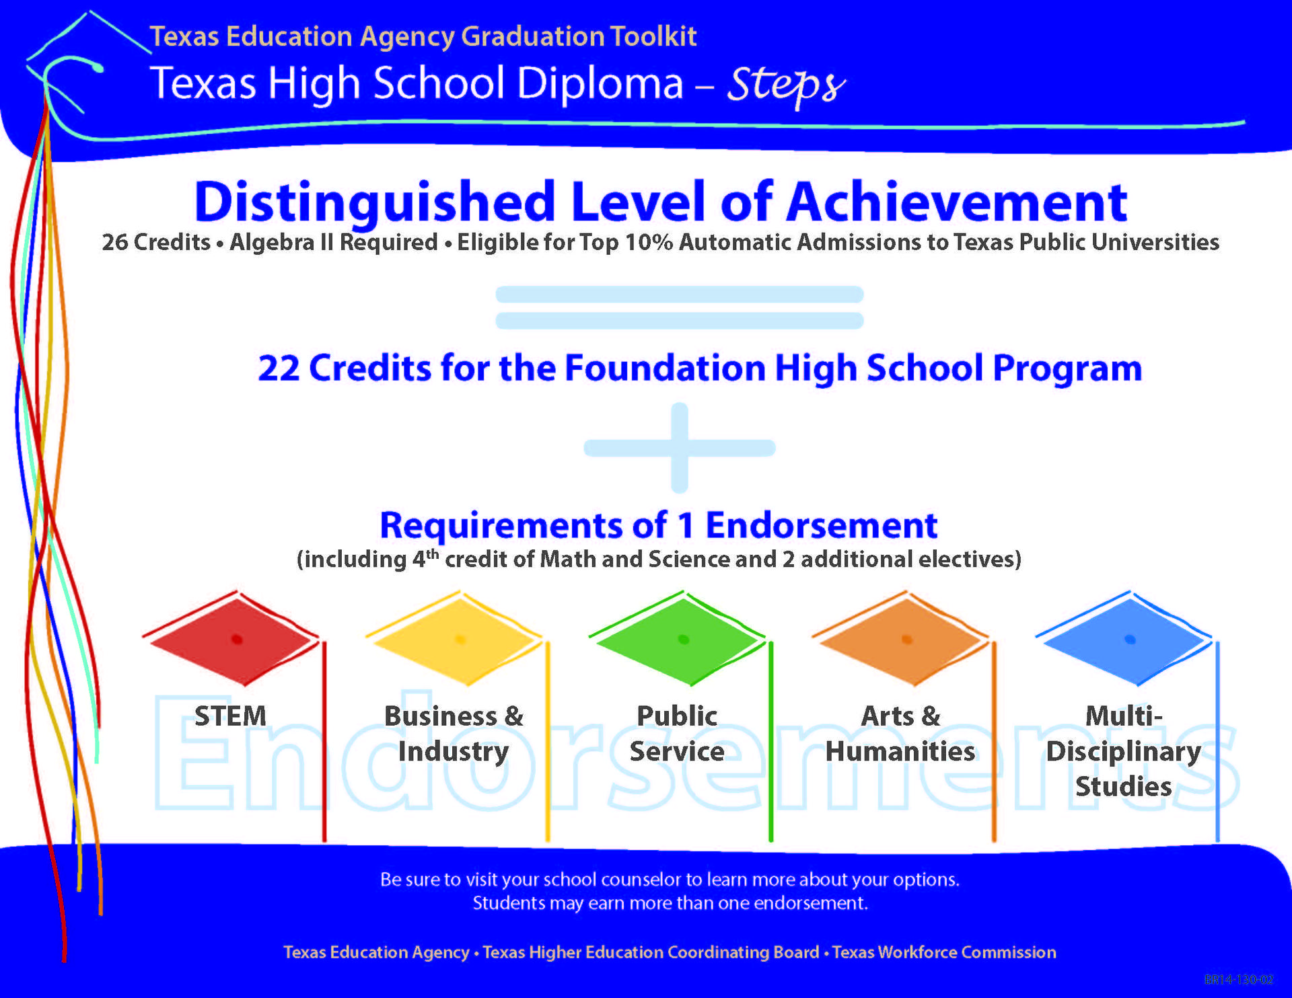
Completing Required High School credits
8th Grade Transition to High School

Slide 13
ENDORSEMENTS (PATHWAYS)
Endorsements (Pathways)

Slide 14
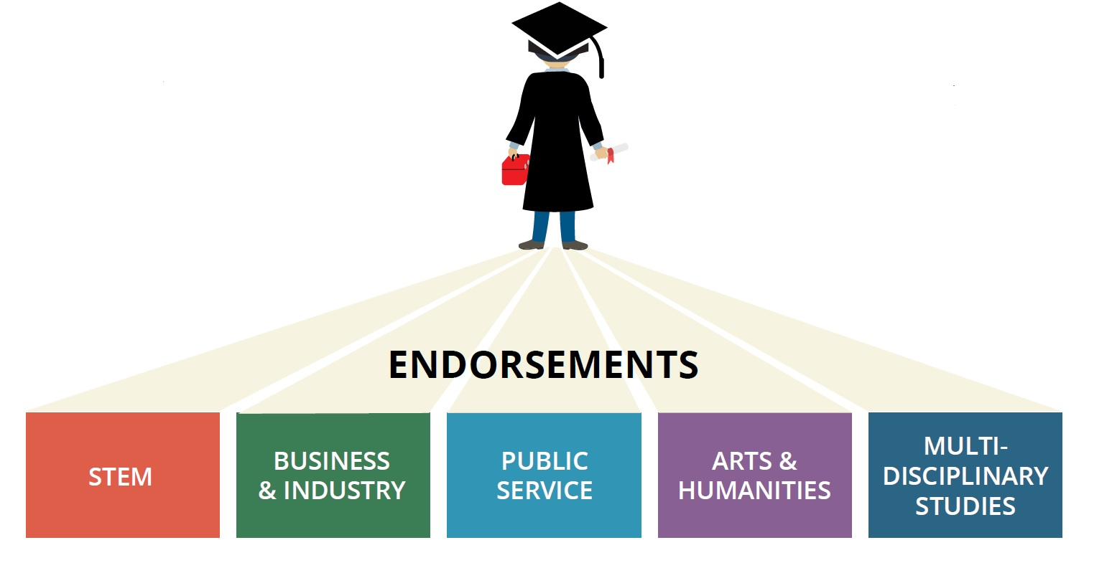
Five Endorsement Options
8th Grade Transition to High School

Slide 15
Endorsements (Pathways)
Endorsements Students entering 9th Grade must choose from one of the following endorsements
STEM (Example: Engineering)
Business & Industry (Example: Business)
Arts & Humanities (Example: Music)
Public Services (Example: Health)
Multidisciplinary Studies (Undecided)

Slide 16
STEM
HSI- Katy offers many CTE pathways with unique skill sets in preparing students for college and the workforce. Including:
Biomedical Science
Engineering
Cybersecurity
Programming and Software development
Web Development

Slide 17
Biomedical Science Pathway
PLTW Courses:
-Principles of Biomedical Science
-Human Body Systems
-Medical Interventions
-Biomedical Innovations
Industry certification (NHA):
EKG Technician (CET)
Medical Assistant (CCMA)
Organization:
HOSA

Slide 18
Technology pathways
Courses
Intro. To Eng. Design (PLTW)
Engineering Science (Principles of Engineering (PLTW))
Engineering Design and Development (PLTW)
Digital Electronics
Foundations of CyberSecurity (PLTW)
Fundamentals of CS
AP CSP and AP CSA
Scientific Research and Design
Independent Study in Technology Application
Digital Media
Engineering
CyberSecurity
Programming and Software Development
Web Development

Slide 19
Technology Pathway (Continued)
Industry certifications:
ACA - Adobe Certified Associate (Digital Media /Graphic Design)
ACU - Autodesk Certified User (CAD in Engineering)
Oracle Java SE 8 programmer certification
CompTIA ITF+ -IT Fundamentals Plus
PCEP - Python Certified Entry/Associate Programmer
Organizations/Competitions:
TSA -Technology Student association
FTC robotics
CyberPatriot

Slide 20
Business & Industry
Potential Classes:
Principles of Business Marketing and Finance
Accounting I
Opportunity to gain industry certifications
Microsoft 365- Excel, Powerpoint and Word
Next Year - ESB (Entrepreneurship and Small Business) Certification
Opportunity to work with the National Junior Achievement (JA) Club and compete for seed money.

Slide 21
Arts & Humanities
(One of the following)
• 2 levels each in two languages other than English (LOTE) Spanish or Turkish
• 4 levels in the same LOTE
• Courses from one or two areas (music, theater, art) in fine arts
Organizations: School Choir, English Honor Society
Spanish Honor society

Slide 23
3. ADVANCED COURSES

Slide 24
Advanced Placement (AP) Courses
Prep for College
AP classes can be as challenging as introductory college courses
Rise to the Top of the Pile
Advanced Placement classes show admissions officers that you're ready for college-level work
Strengthen Your Transcript
Many high schools give extra weight to AP grades when calculating your GPA.
Study What You Love
There are divers range available AP Courses
Save Money
A score of a 3 or higher would allow you to earn college credits without paying college tuition
Challenge
Rigor Curriculum
Completion of Summer Assignments
+All AP courses carry a 5.0 weight

Slide 25
AP Classes
AP Environmental Science
AP Art & Design
AP Biology
AP PreCalculus
AP Environmental Science
AP Computer Science Principle
AP Computer Science A
AP Psychology/Psychology
AP Human Geography
AP World History
AP English Language
AP English Literature
AP Calculus AB
AP Calculus BC

Slide 26
Dual Credit Courses
Earn a College Credit
Dual Credit courses are designed to help student earn college credits while in high school.
No Exam
Unlike AP, students in Dual Credit do not have to take an exam in order to earn college credit
Will Appear
Unlike AP, if a student is unsuccessful in Dual Credit, the grade will appear on the student’s college transcript

Slide 27
Dual Credit Courses (Cont..)
GPA Weight
All Dual Credit course carry an 5.0 weight except the ones taken during the summer. Summer dual classes will be 4.0 GPA.
Eligibility
Students must take and pass the TSI exam in order to take a Dual Credit course
End of the Semester
Students who enroll in Dual Credit courses will earn college credit at the end of the semester

Slide 28
AP vs. Dual Credit
Advanced Placement (AP)
College Credit
Exam (A score of a 3 or higher)
Will NOT Appear if you fail
Eligibility Criteria
GPA Weight 5.0
All Around
Dual Credit Course
College Credit
No Exam, Just Course Finals
Will Appear if you fail
Eligibility Criteria
GPA Weight 5.0
In-State Acceptance

Slide 29
On-Ramp Courses (Dual)
GPA Weight
All Dual Credit course carry an 5.0 weight.
Eligibility
1. Students must take and pass the TSI exam (all sections) and be approved by a teacher in order to take a Chemistry On Ramp course.
2. Students must take and pass Pre-Calc Dual in order to Physics-D
End of the Semester
Students who enroll in Dual Credit courses will earn college credit at the end of the semester.
+All on-ramp courses carry a 5.0 weight

Slide 30
Project Lead the Way (PLTW) Courses
Solve Real World Problems
PLTW courses give students the opportunity to learn how to solve real-world problems while collaborating with classmates
Three Main Areas
We offer courses in Computer Science, Biomedical Science and Engineering
Hands-On activities
We create an engaging classroom environment using hands-on activities unlike any other
+All PLTW courses carry a 4.0 weight

Slide 31
Project Lead the Way (PLTW) Courses
Solve Real World Problems
PLTW courses give students the opportunity to learn how to solve real-world problems while collaborating with classmates
Three Main Areas
We offer courses in Computer Science, Biomedical Science and Engineering
Hands-On activities
We create an engaging classroom environment using hands-on activities unlike any other
+All PLTW courses carry a 4.0 weight

Slide 32
Summer/Online Courses
All summer or online courses carry a weight of 4.0 GPA
Remember you need approval letter from your counselor.

Slide 33
5.
COLLEGE & CAREER COUNSELING SERVICES

Slide 34
HSI-Katy CC Services
Individual Counseling
Individual Counseling
Career Exploration
Academic Advising
Post-Secondary Education Planning
Parental Counseling & Support
Parent Nights
FAFSA Night
Academic Support
College List, Application Assistance, Resume Dev.
College Visits, Essay Development
Post Secondary Financing

Slide 35
Graduation Roadmap
Transcript Check in Every Semester thr 1-on-1 Meetings
Financial Aid Support, 1-on-1 Follow Up, Submission Support
College Panels with Alumni Students, Transition Activities
PostSecondary Support
1
3
5
7
2
4
6
College Application, Rec. Letter, College List, SAT Prep., etc..
College Tours, Parent Nights, Bootcamps
Graduation Checklist to Make Sure A Student Graduates on Time

Slide 36
6.
EXTRACURRICULAR ACTIVITIES

Slide 37
This is What We Do
Academic Competitions
Athletics
Student Clubs
Volunteer Programs

Slide 38
Academic Clubs
Cyber Patriot
Robotics Club
STEM Scholars (Science Fair Scholars, NASA Techrise)
Name That Book
CRLP
Turkish speech and art contest
HOSA
SkillsUSA
Scale Modeling
AMC

Slide 39
Athletics
Basketball
Cross Country
Football
Soccer
Track&Field
Volleyball

Slide 40
Student Organizations
CRLP
Service Leadership Society
Red Cross
Student Council
National Honor Society
NJHS
Key Club

Slide 41
Curricular Clubs
Table Tennis
Drumline
Hispanic Student Association
MENA Club
Outreach Club
Asian Creativity Club
ASA-Dance
ASA-Art and Humanities
Yearbook
Crochet Club

Slide 42
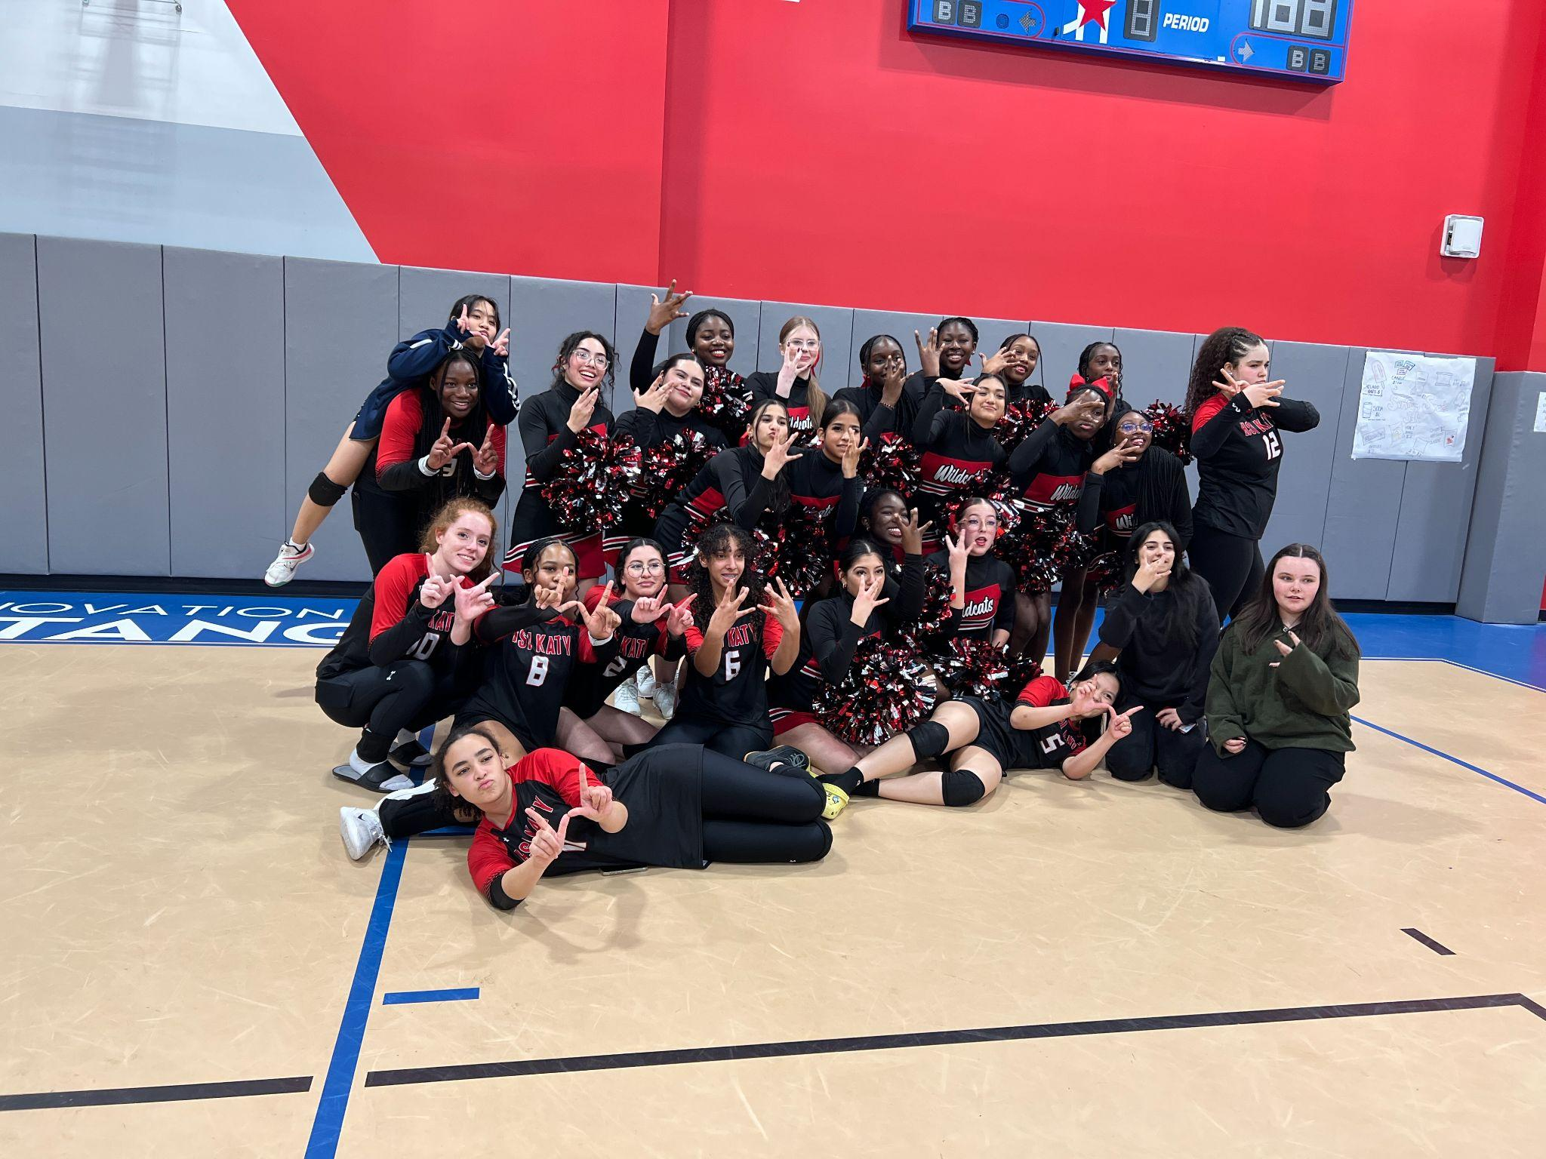

Slide 44
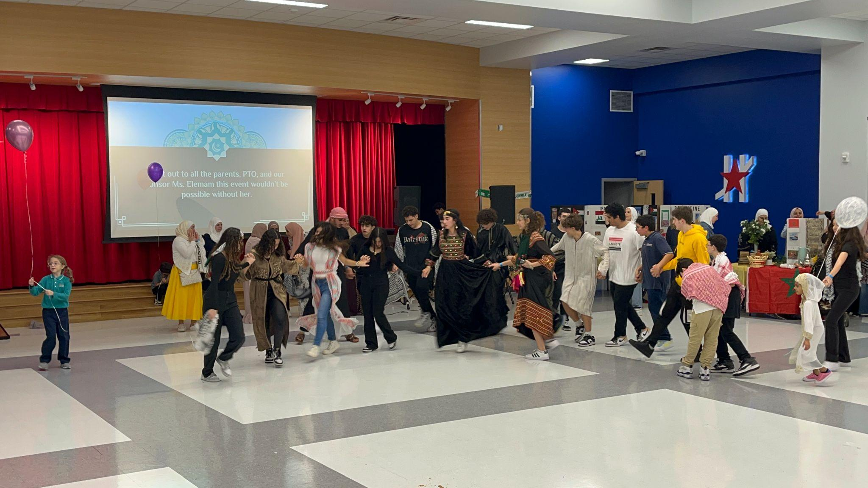

Slide 45
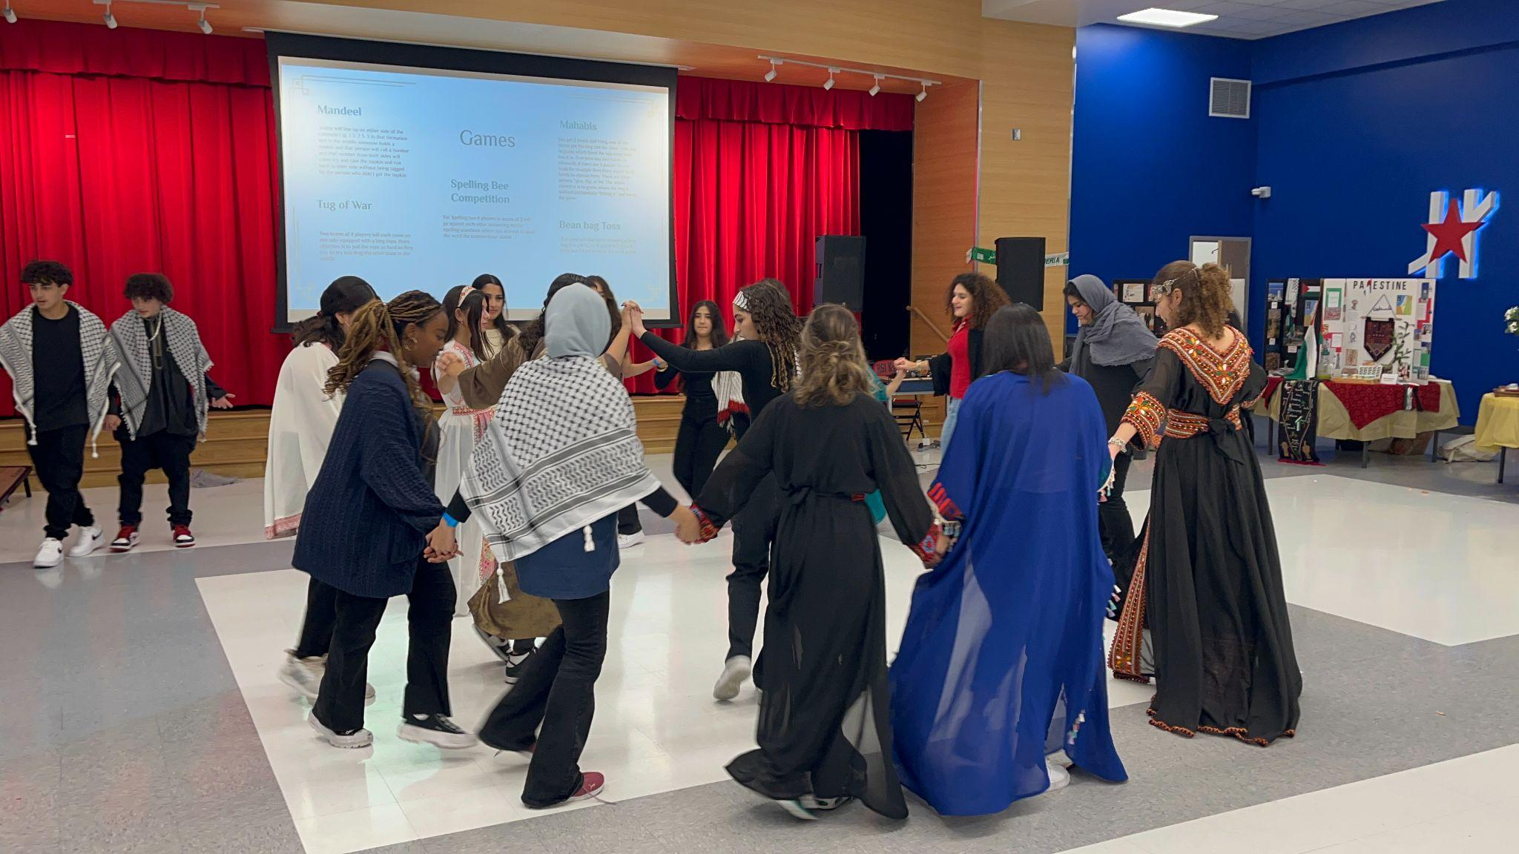

Slide 46
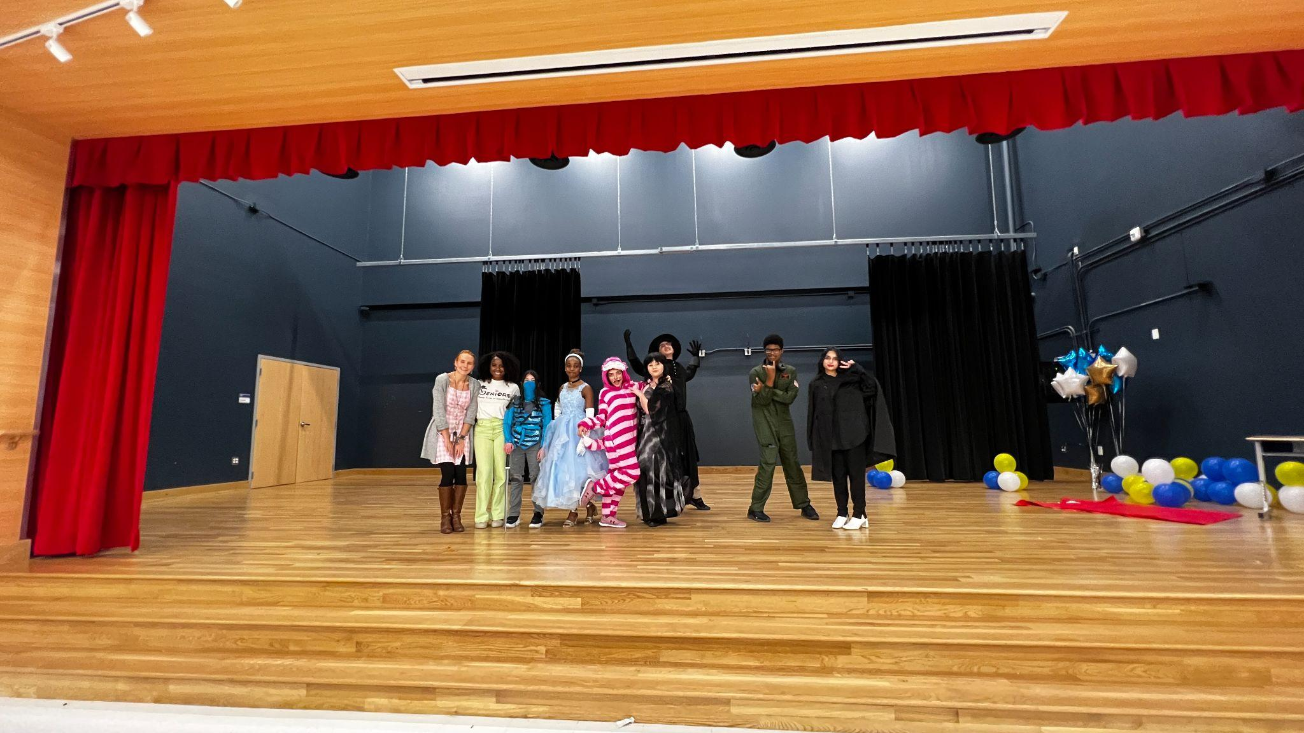

Slide 47
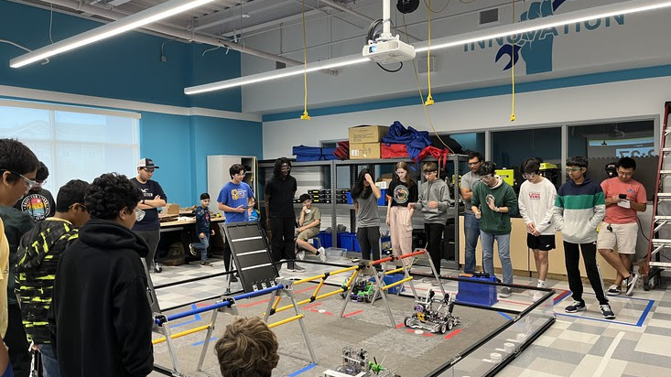

Slide 48
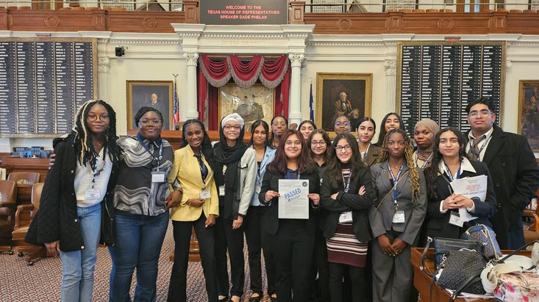

Slide 49
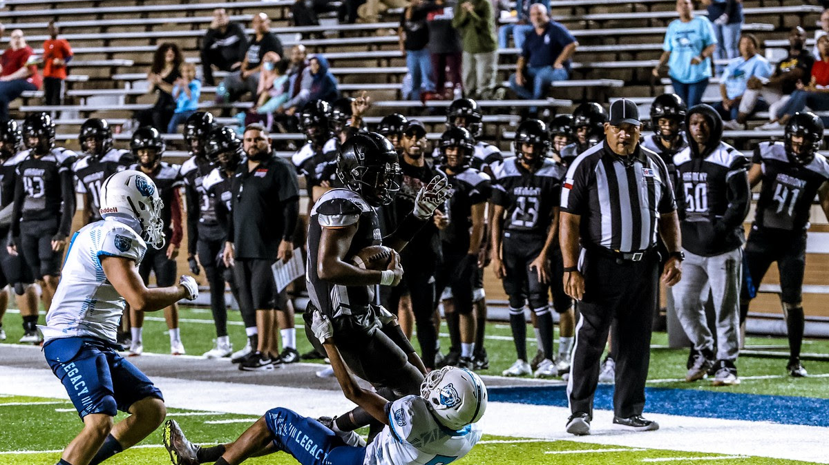

Slide 53
7.
TRANSITION CALENDAR

Slide 54
Parent/Guardian Academic Night
8th Grade Course Selection Meetings End
Course Selection Meeting Ends
Loan Star Dual Enrollment Deadline
Dec 7
Jan 9
Jan 26
Jan 29
Mar 8
January 22 -March 17
Mar 25 -April 26
May 10 - 15
8th Grade Course Selection Meetings Start
High School Course Selection Meetings Start
HCC Dual Enrollment Submission Deadline
Schedule correction timeline

Slide 55
8.
HIGH SCHOOL SCHEDULE

Slide 56
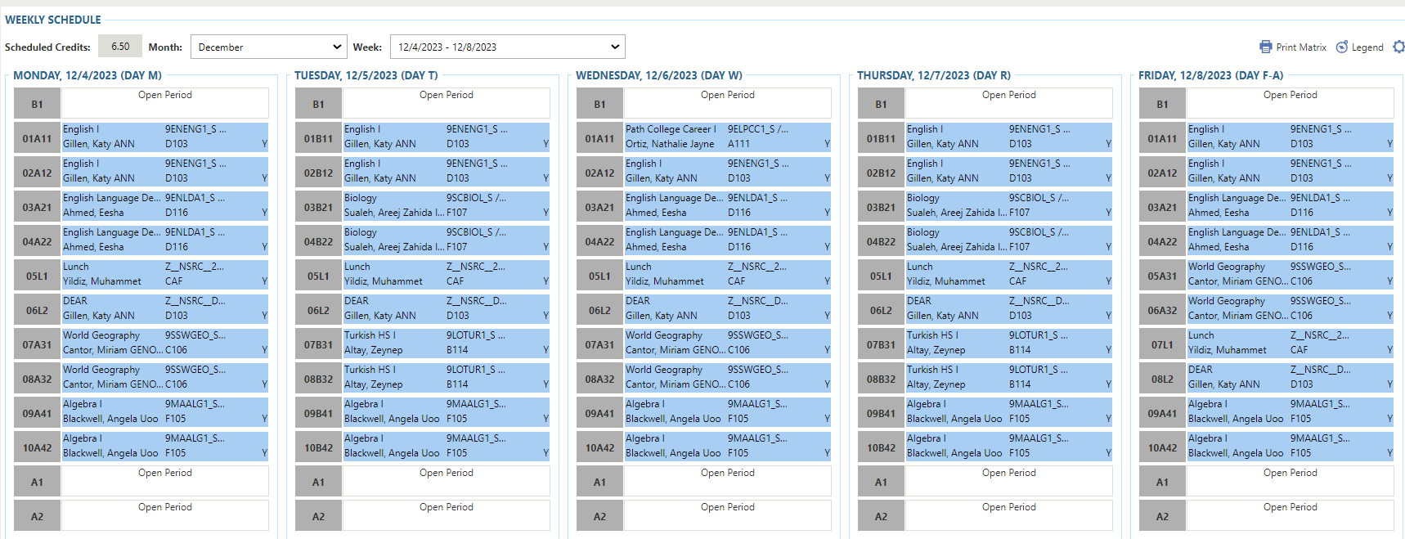
Sample Student Schedule

Slide 57
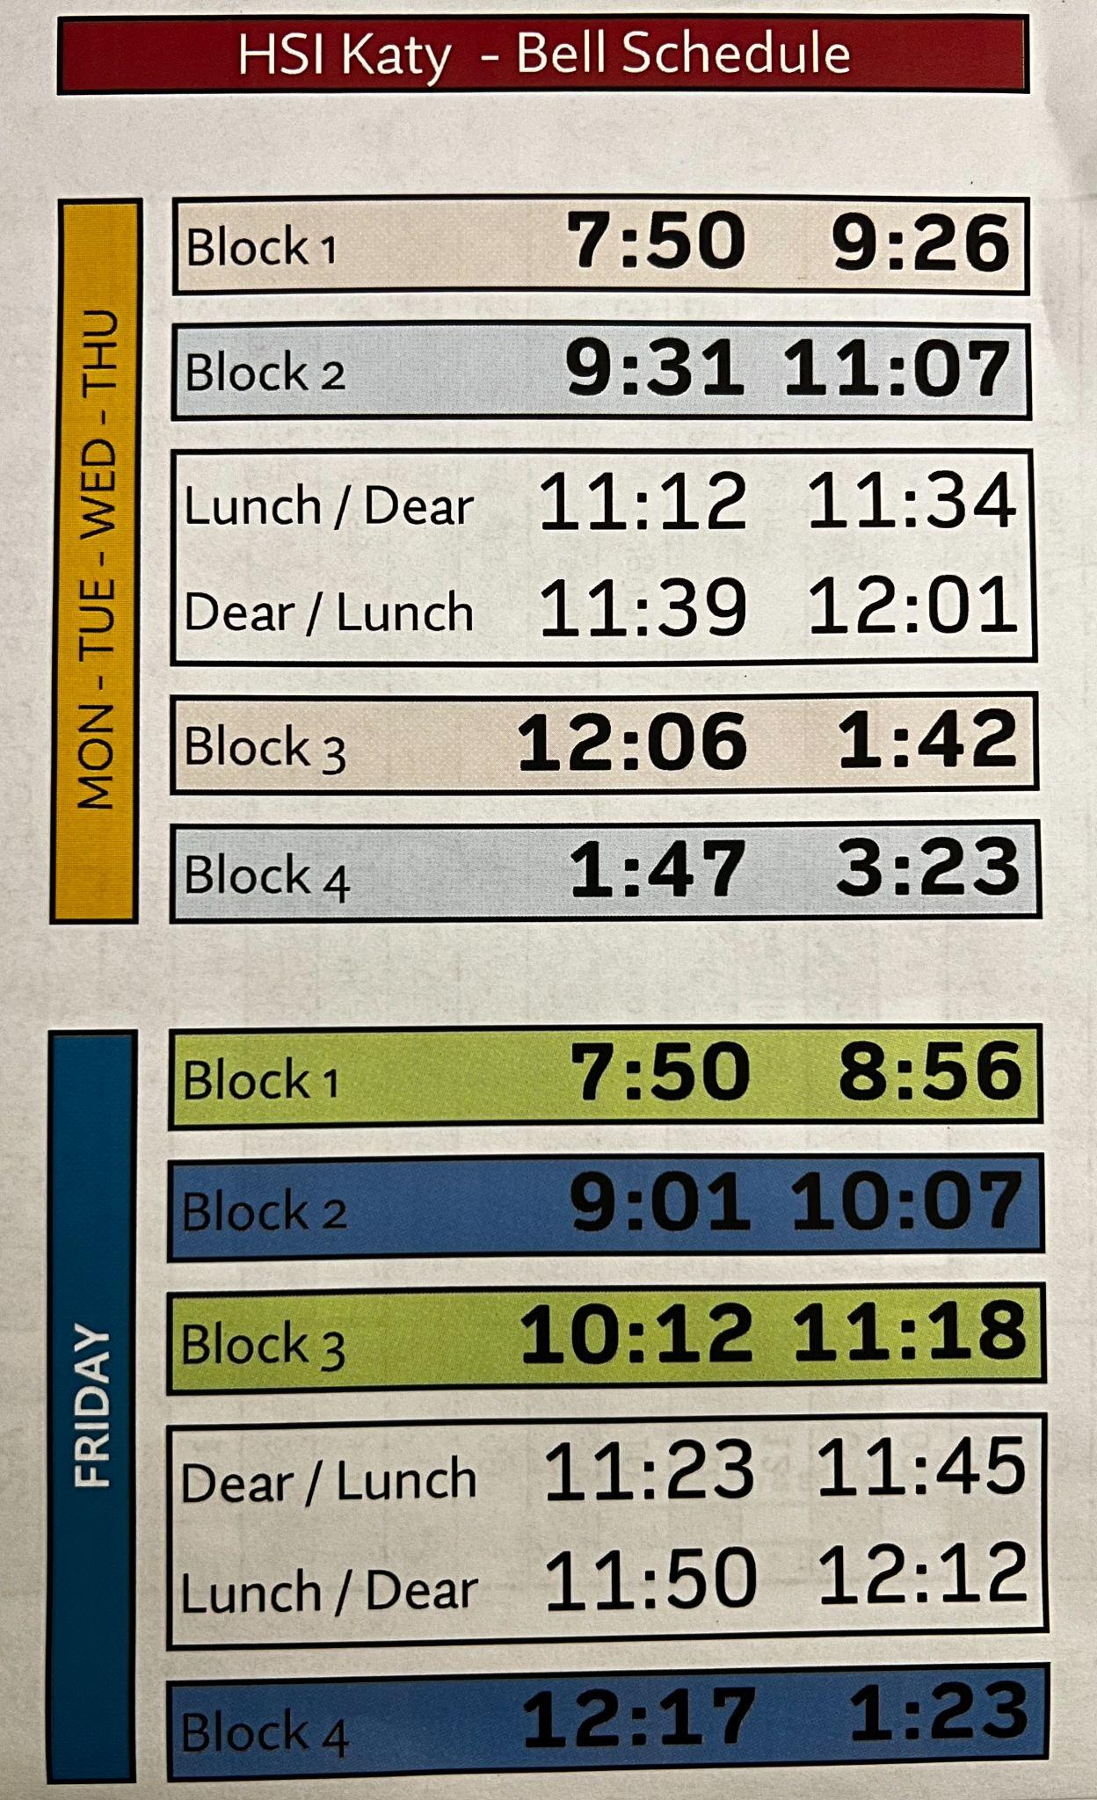
Tentative Sample Bell Schedule

Slide 58
9.
COURSE SELECTION PROCESS
9th Grade Curriculum
Notes:
Ortiz

Slide 59
Recommendations
Test Results
Current Grades
Teacher Rec. Letters
Eligibility Criteria to Enroll in Advanced Courses
PSAT
MAP
TSI
Straight A`s for All Courses especially in all Core Subjects
Math
English
Science
Social Studies
Teacher rating based on preparation for class, classwork, self advocacy and independence as a learner

Slide 60
Course Selection Process
HSI-Katy course selection guide will be available on the website on December 14th, 2023
Beginning December 14th-January 08, students and parents/guardians review the course catalog to prepare their DRAFT course list.
Students and parents/guardians schedule 1-on-1 course selection meetings that will be held on the campus in-person with counselors
High School counselors meet with middle school students to review and finalize course selections and to answer any questions

Slide 61
STEPS ON COURSE SELECTION
Step 1: Review the Course Catalog
Step 2: Discuss the Courses with Parents
Step 3: Set Up Your Meeting with a Counselor
Step 4: Select Your Courses Carefully
Step 5: Submit Correction Form If Needed

Slide 62
Respect Deadlines

Slide 63
10.
RESOURCES & SUPPORT
Let’s start with the first set of slides

Slide 64
RESOURCES & SUPPORT
Technical Equipments such as Chromebooks, Laptops, Calculators, etc..
Science, Technology, Engineering, and Medical Courses Labs
Tutor Me: Free Harmony Dashboard
Teacher Office hours
Behavioral Counselor Mr. Flanagan

Slide 65
RESOURCES & SUPPORT (Cont.)
Academic Enrichment: Students must be recommended by a teacher to be placed in Academic Enrichment after school. Students work individually or in small groups in math/science or history/English or World Language.
Wellness Counselor: A counselor is available at both high schools to provide one-on-one support regarding a variety of wellness issues including but not limited to peer interactions, stress, mental health concerns, etc.

Slide 66
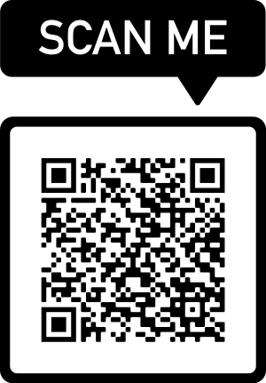
NOW!!!
SCHEDULE
YOUR
MEETING

Slide 67
Thanks!

